Slide 1

TERMINALIA

Slide 2
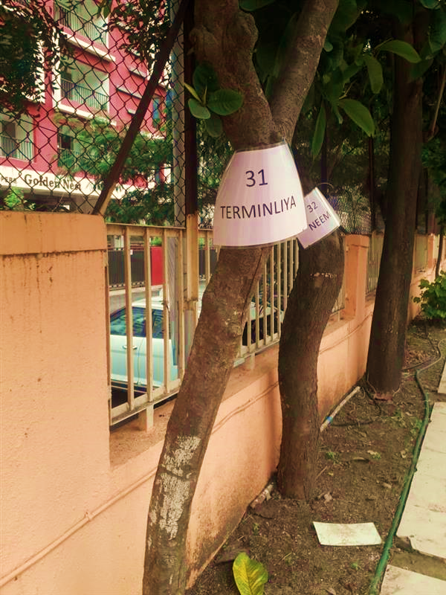
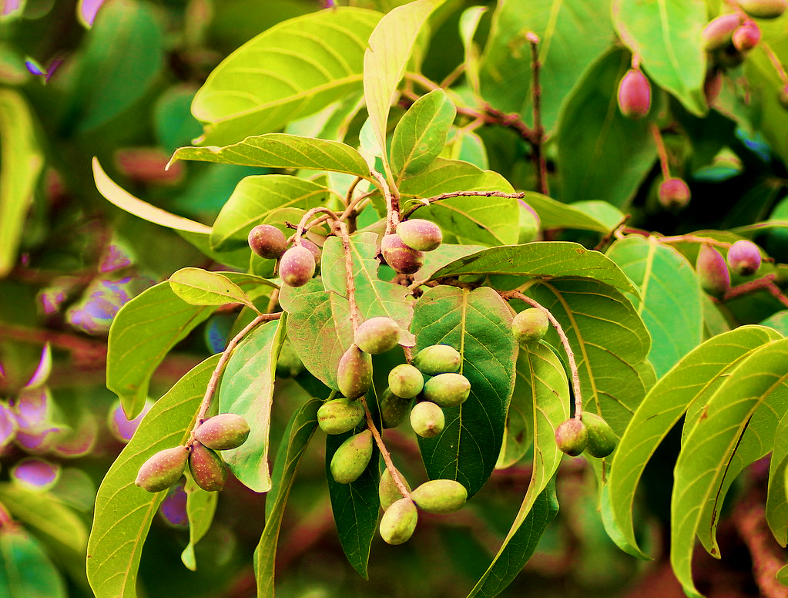
Near Turf Court(Behind Volleyball Court)
TERMINALIA

Slide 3
Common name: Tropical almond or Indian almond
Scientific Name: Terminalia catappa
Family: Combretaceae
Habit: Terminalia catappa a tree up to 25 meters in height and a trunk to 1.5 meters. The s leaves are arranged alternately, to 25 centimetres in length, ovate to oblong, with an entire leaf margin. The leaves are clustered at the ends of short branches each of which separated by 10-15 centimetres.
Distribution: Terminalia is found throughout native to Asia, Australia, the Pacific, Madagascar and Seychelles.

Slide 4
Description :
The tree grows to 35 metres (115 feet) tall, with an upright, symmetrical crown and horizontal branches. The fruit is corky and light and dispersed by water. As the tree gets older, its crown becomes more flattened to form a spreading, vase shape. Its branches are distinctively arranged in tiers. The leaves are large, 15–25 cm long and 10–14 cm broad, ovoid, glossy dark green, and leathery. They are dry-season deciduous; before falling, they turn pinkish-reddish or yellow-brown, due to pigments such as violaxanthin, lutein, and zeaxanthin
The trees are monoecious, with distinct male and female flowers on the same tree. Both are 1 cm (³⁄₈ in) in diameter, white to greenish, and inconspicuous with no petals; they are produced on axillary or terminal spikes. The fruit is a drupe 5–7 cm long and 3–5.5 cm broad, green at first, then yellow and finally red when ripe, containing a single seed.

Slide 5
Uses :
Various plant parts are used medicinally to treat dysentery, leprosy, coughs, jaundice, indigestion, headaches, colic, pain and numbness, fever, diarrhea, sores, skin diseases, diabetes, etc. The seeds can be either raw or cooked.
Catappa leaves' allure lies in their benefits: boosting fish health, improving water quality, and enhancing aquarium aesthetics. These leaves are like a spa treatment for fish, offering relief from stress and ailments while fostering a more robust immune system.
The wood is red and solid, and has high water resistance; it has been used in Polynesia for making canoes.

